Slide 1
Team VTD
CTfastrak Project
Karthigaa Vijayakumar, Kevin Daley, Khuong Tong

Slide 2
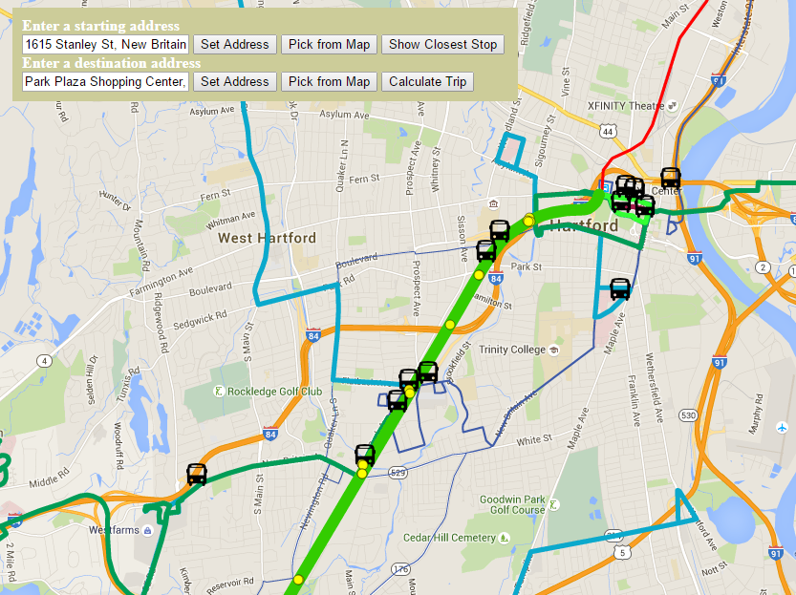
CTfastrak Project
Displays live information for the CTfastrak line
Web application to display location of CTfastrak buses
Uses Google Maps API
Live data from CTfastrak JSON feed

Slide 3
Features
Bus location and routing information for a trip
Live bus map
Ability to locate the nearest CTfastrak bus stop
Allows users to input location and intended destination
Calculate a route
Display instructions in side bar
Static information show in the side bar

Slide 4
Lessons Learned
Cannot easily estimate size, scope, or difficulty
Need to limit project scope
Estimating story size
Difficulty of accurately gauging stories
Unexpected issues
Difficulty finding the right solutions to problems
Changes in API features
Need to control dependence on outside entities

Slide 5
Demonstration and Questions
Link to live map:
http://kvn-dly.github.io/

